Slide 1
Introduction to Lego EV3
Summit Denali
Vasu Dalal (vdalal@gmail.com)
https://github.com/vdalal/lego-ev3

Slide 2
Goal: Demo Day
Goals
Avoid crashes
Stay in the playpen
Move continuously
Learn & have fun!

Slide 3
Rough Class Schedule & Plan – (1)
Reference: https://docs.google.com/document/d/1ODXoy8ChpRAfU1ifJo9y75IHdOogI4xekYyTUXGOlkM/edit
Week | Plan | Comments
Week #1 | Introduction - 5 mins EV3 Kit, sensors, code, download etc. Logistics - 5 mins EV3 proficiency, split into groups Norms Discuss - 10 mins Session Goal: Demo Bot MUST work cooperatively (avoid obstacles, not crash) Stay within boundary Discuss/Debate sensor options Build - Driver Base (start) - 45 mins Program - Driver Base Download code Move straight line, move back/forth, & turn Loop(s) Review Goal(s) | 2 students/group, 8 groups, 8 kits Everyone does the same build so we can help each other Challenge: our builds can interact with each other
Week #2 | Discuss: Goal(s) - Session goals Finalize sensor options Program - Driver Base (continued) Move straight line, move back/forth, & turn Loop(s) Add another sensor e.g. ultrasonic sensor Detect obstacle, Stop on obstacle, avoid (turn) on obstacle Add Movement - back/forth & turn Challenge: Display: STOP Sound: Make sound #1 for 3 secs Move back slowly Review Goal(s) | Challenge based on discussion with students

Slide 4
Rough Class Schedule & Plan – (2)
Reference: https://docs.google.com/document/d/1ODXoy8ChpRAfU1ifJo9y75IHdOogI4xekYyTUXGOlkM/edit
Week | Plan | Comments
Week #3 | Discuss Goal(s) - Session goals Add ONE sensor e.g. light sensor Stay within boundary Stop at line boundary, turn back/around Challenge Kill switch: Touch Sensor Display: END Sound: Make sound #2 for 3 secs Move back slowly Review Goal(s) | Challenge based on discussion with students
Week #4 | Discuss Goal(s) - Session goals Program Challenge Simulate a traffic light Stop & Start Catchup Challenge: Stop at line, turn back/around | Challenge based on discussion with students
Week #5 | Discuss Goal(s) - Session goals Program Demo! Catchup Challenge Stop at line, turn back/around Autonomous driving Review Session Goal(s) Inventory the kits

Slide 5
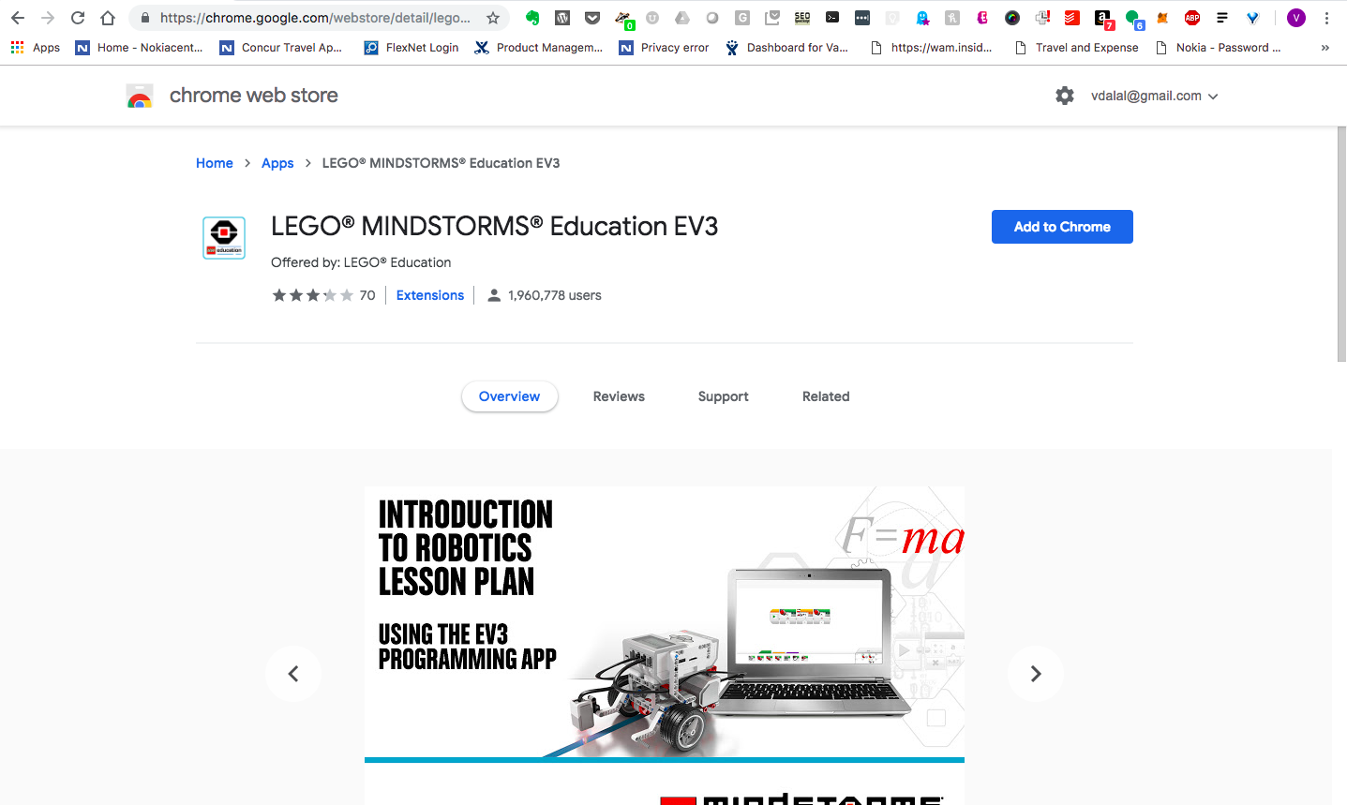
Chrome Web Store

Slide 6
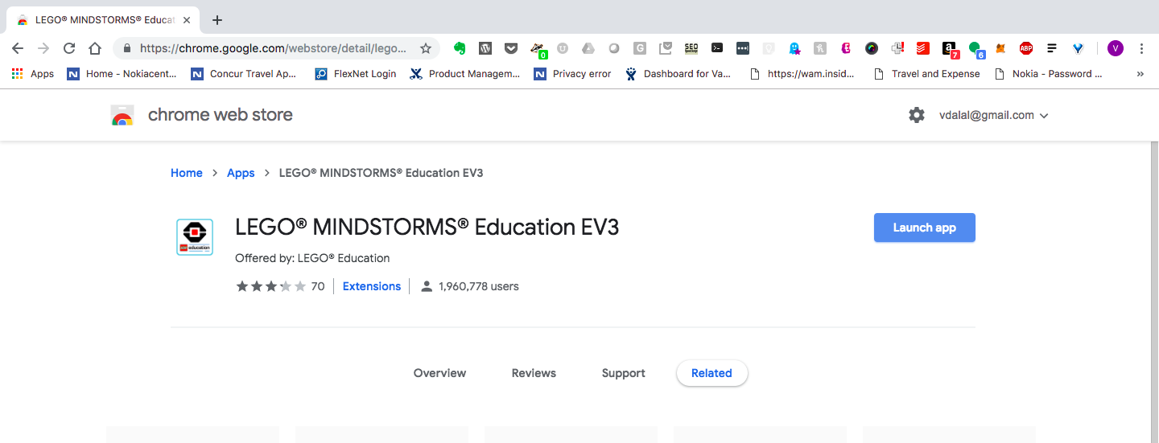
Launch App

Slide 7
FAQ
https://le-www-live-s.legocdn.com/sc/media/files/primary/engb%20campaign%20middle%20school%20ev3%20chromebooks%20faqs-80bbd7d15963de5d20a786819aa67ace.pdf?la=en-gb
https://education.lego.com/en-us/support/mindstorms-ev3/software-requirements
Chromebook
Operating system:
Chrome OS version 50 or above
Hardware:
4 GB RAM or more
1.40 GHz dual-core processor or faster
2 GB available storage space
Bluetooth 2.0 or above
Available on Chrome Web Store.
Firmware update compatibility. To confirm that your Chromebook is able to update the firmware on your EV3 Brick via USB, please open the Chrome web browser in your Chromebook and enter ‘chrome://system’ in the address bar. Locate the version number under ‘uname’. If you have version 3.14 or above, then you should be able to update your EV3 Brick via EV3 Programming. If not, please update your EV3 Brick from the EV3 Lab software.

Slide 8
Discussion Topics
Each bot acts on their own. Do the actions need to be coordinated?
How does the bot detect another bot?
What sensors shall we use?
What speed should the bot be moving at?
What should occur when your bot detects another bot?
Does can the bot avoid another bot? Does the direction of turn matter?
How does the bot stay within the playpen? How does your bot detect the red border?
What other improvements can we make? Speed? Finetune turns? etc.

Slide 9
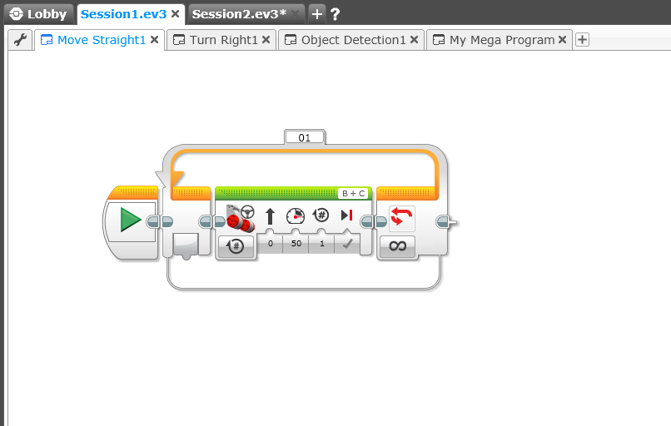
Step #1: Go Straight
Move Tank
Loop (forever)

Slide 10
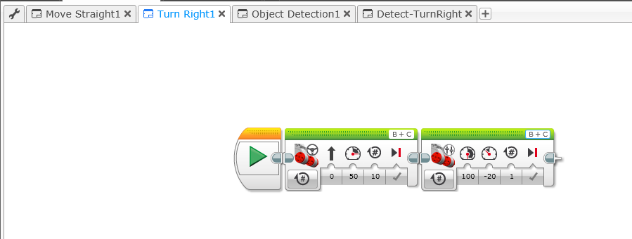
Step #2: Go Straight, Move Right
Left/Right Motor Controls
Move Tank

Slide 11
(optional) Step #2: Go Straight, Turn 180
Left/Right Motor Controls
Move Tank

Slide 12
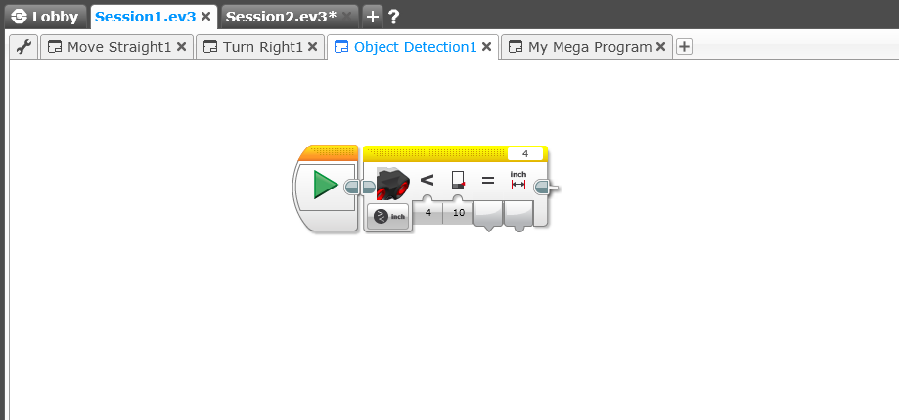
Step #3: Object Detection – (1)
Ultrasonic Sensor
Distance Detection
Controls

Slide 13
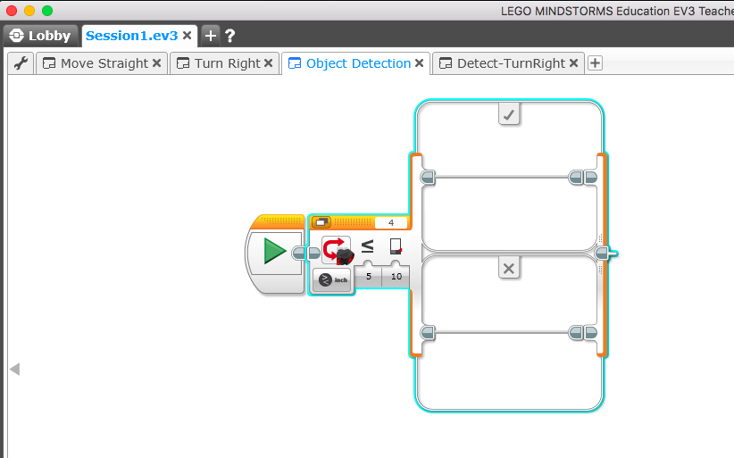
Step #3: Switch Block, Object Detection – (2)
Switch Block
If (condition = ‘Yes’)
Do this
Else
– Do that
Turn right (or 180)
Detect object
<=10 in?
Do nothing
Ultrasonic Sensor
Compare

Slide 14
Milestone #1: Detect & Turn Right (Avoid) - Pseudocode
start
Move
straight
Detect object
<=10 in?
no
yes
Turn right (or 180)

Slide 15
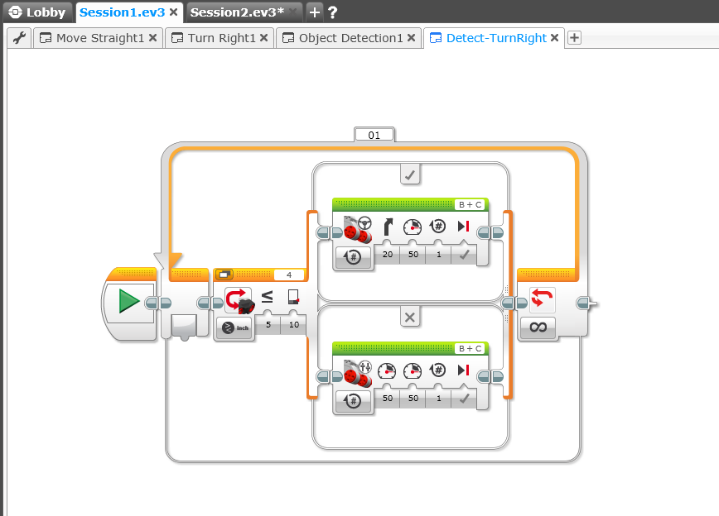
Milestone #1: Detect Object & Turn Right (Avoid) - Code
If (object within 10 inches)
- Turn right
Turn right (or 180)
Detect object
<=10 in?
Go straight
Else
- Go straight
Ultrasonic Sensor

Slide 16
Step #4: White border Detection – (1)
Light Sensor
- Reflected light intensity
Distance Detection
Controls

Slide 17
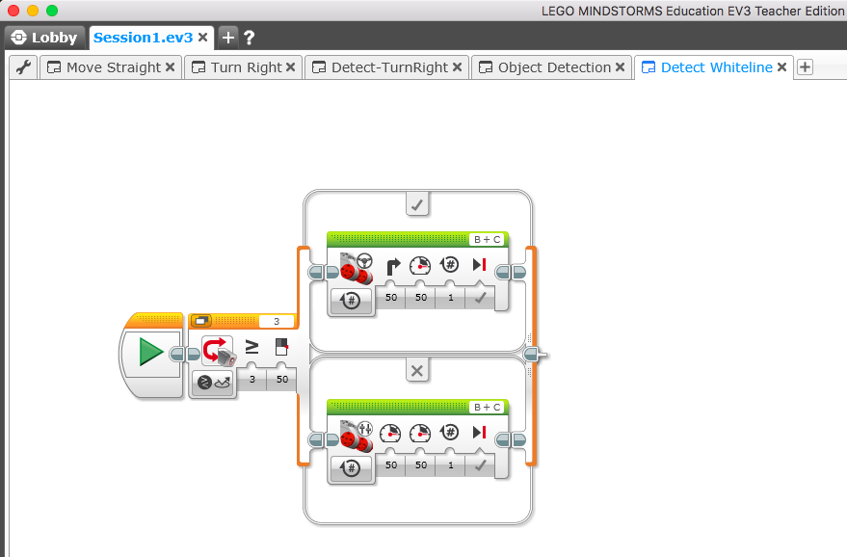
Step #4: White border Detection – (2)
Turn right (or 180)
If (white border = ‘yes’)
- Turn right
Reflected intensity >=60?
Go straight
Else
- Go straight
Light Sensor
- Reflected light intensity
Copyright © Vasu Dalal

Slide 18
Milestone #2: Detect & Avoid Object + Stay in Playpen
Option #1
start
Move
straight
Move
straight
Detect object
<=10 in?
Detect white border
?
no
no
yes
yes
Turn right (or 180)
Turn right (or 180)

Slide 19
Milestone #2: Detect & Avoid Object + Stay in Playpen
Option #2
start
no
Move
straight
Detect white border
?
yes
Detect object
<=10 in?
no
yes
Turn right (or 180)

Slide 20
Milestone #2: Detect & Avoid Object + Stay in Playpen
Option #3
start
Move
straight
Detect object
<=10 in?
no
no
Detect white border
?
yes
yes
Turn right (or 180)

Slide 21
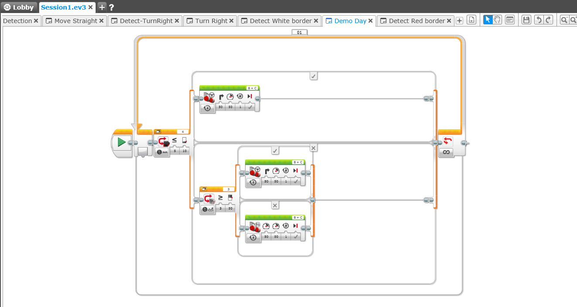
Demo Day
Turn right (or 180)
Detect object
<=10 in?
Turn right (or 180)
Reflected intensity >=60?
Object Sensor
Go straight
Else
- Go straight
If (whiteborder = ‘yes’)
- Turn right

Slide 22
Goal: Demo Day
Goals
Avoid crashes
Stay in the playpen
Move continuously
Learn & have fun!
Thank you!
https://github.com/vdalal/lego-ev3

